Slide 1
Software Evaluation
(Solid Apps Monitoring)

Slide 2
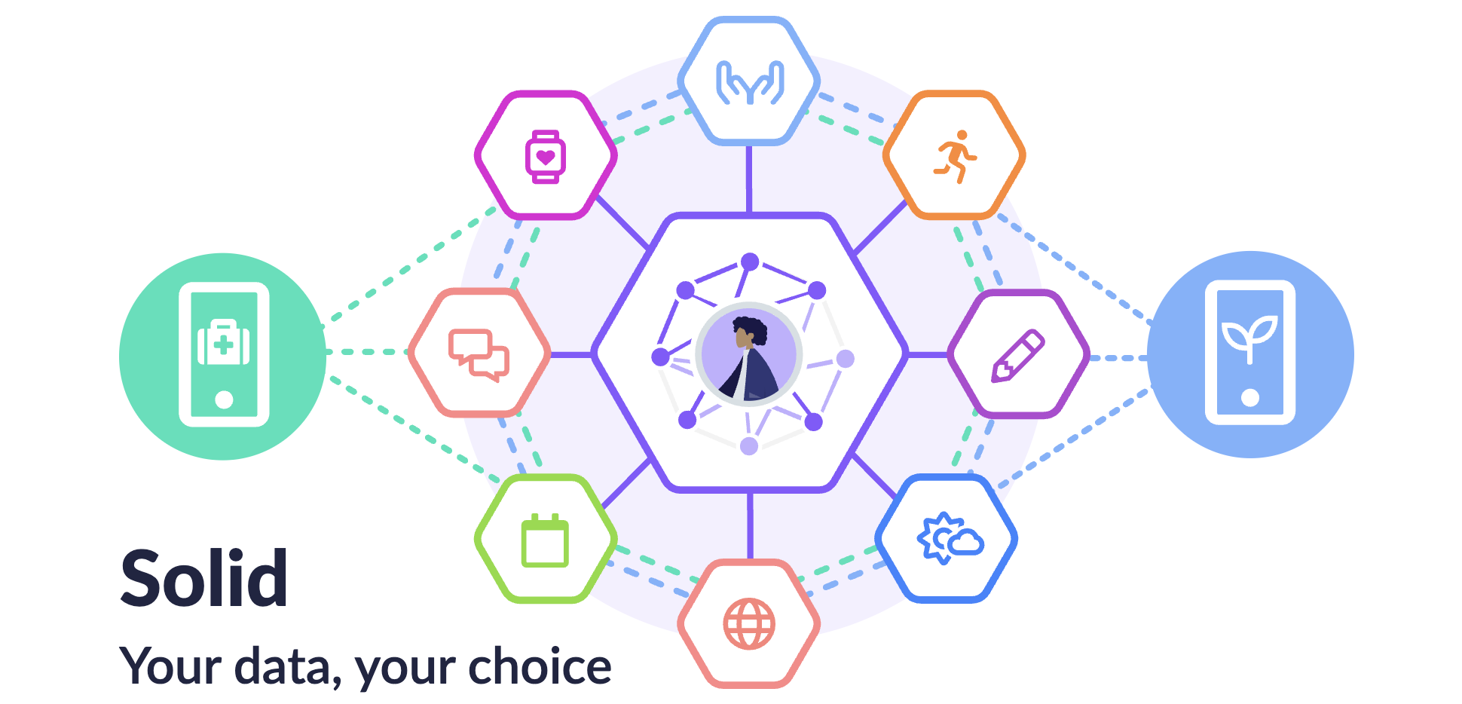
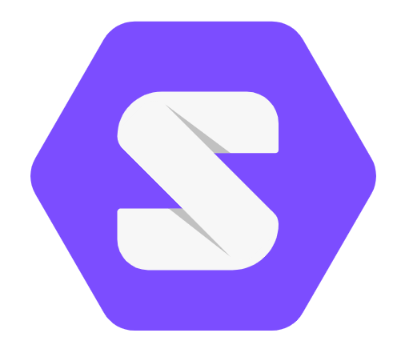
Introduction : What is Solid Pods?
Solid Pod (Personal Online Data Store)
A Solid Pod is a personal data storage space owned and controlled by the user.
Developed as part of the Solid (Social Linked Data) ecosystem.
Separates user data from the applications that consume it.
Enables users to store, manage, and share their data independently.
Applications can only access data with user authorization.

Slide 3
Key Characteristics of Solid Pod
User Data Ownership
Users maintain full ownership and control of their personal data.
Data access is granted only with user authorization.
Decentralization
Data is stored independently from application providers.
Eliminates dependence on a single centralized platform.
Access Control & Privacy
Fine-grained permissions can be defined by users.
Supports secure and privacy-preserving data sharing.
Interoperability & Portability
Data can be shared across multiple Solid-compatible applications.
Users can switch applications without losing their data.

Slide 4
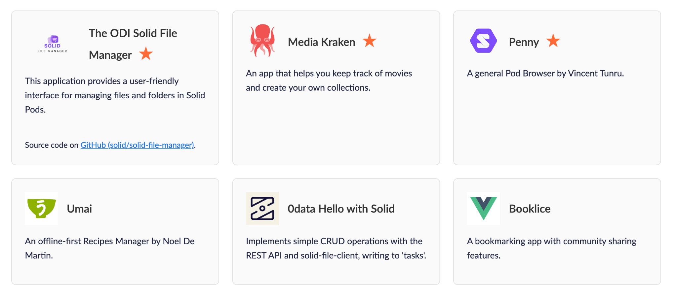
Existing Applications Built on Solid Pods
Solid has been adopted across various domains, demonstrating the flexibility of decentralized personal data storage
While many Solid applications focus on data storage and sharing, limited attention has been given to monitoring data access activities and policy compliance, motivating the development of the proposed Solid-App Monitoring System.

Slide 5
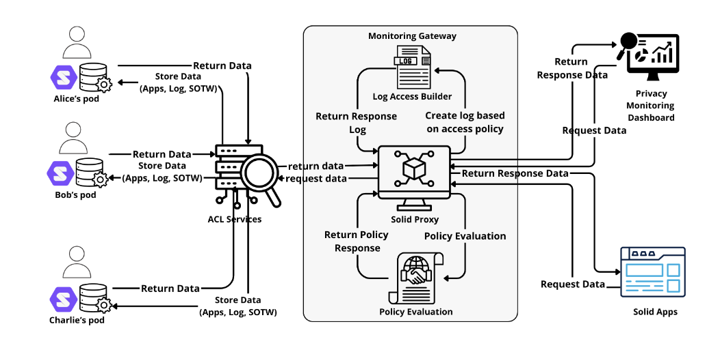
Solid Application Monitoring
Many Solid-based applications have been developed, but users have limited visibility into how their personal data is accessed and used.
Users may find it difficult to track data access activities and identify policy violations across applications.
Solid Application Monitoring provides transparent monitoring, policy compliance verification, and access violation detection for personal data usage.

Slide 6
Solid Application Monitoring (Evaluation)
Evaluation Parameters
1. User Experience Evaluation
Measures usability, clarity, ease of use, and overall user satisfaction.
Assesses users' perceptions when interacting with the Solid-based monitoring system.
2. Functionality Evaluation
Measures the effectiveness and correctness of system features.
Verifies whether each function operates according to the intended requirements.
Evaluation Sections
Register & Authentication :Account registration and Solid login process.
Sensitive Data Settings :Configuration and management of sensitive personal data.
ODRL Policy Settings : Creation and application of access control policies.
External Application Testing : Data access requests and policy enforcement validation.
History Monitoring : Monitoring, auditing, and violation detection of data access activities.

Slide 7
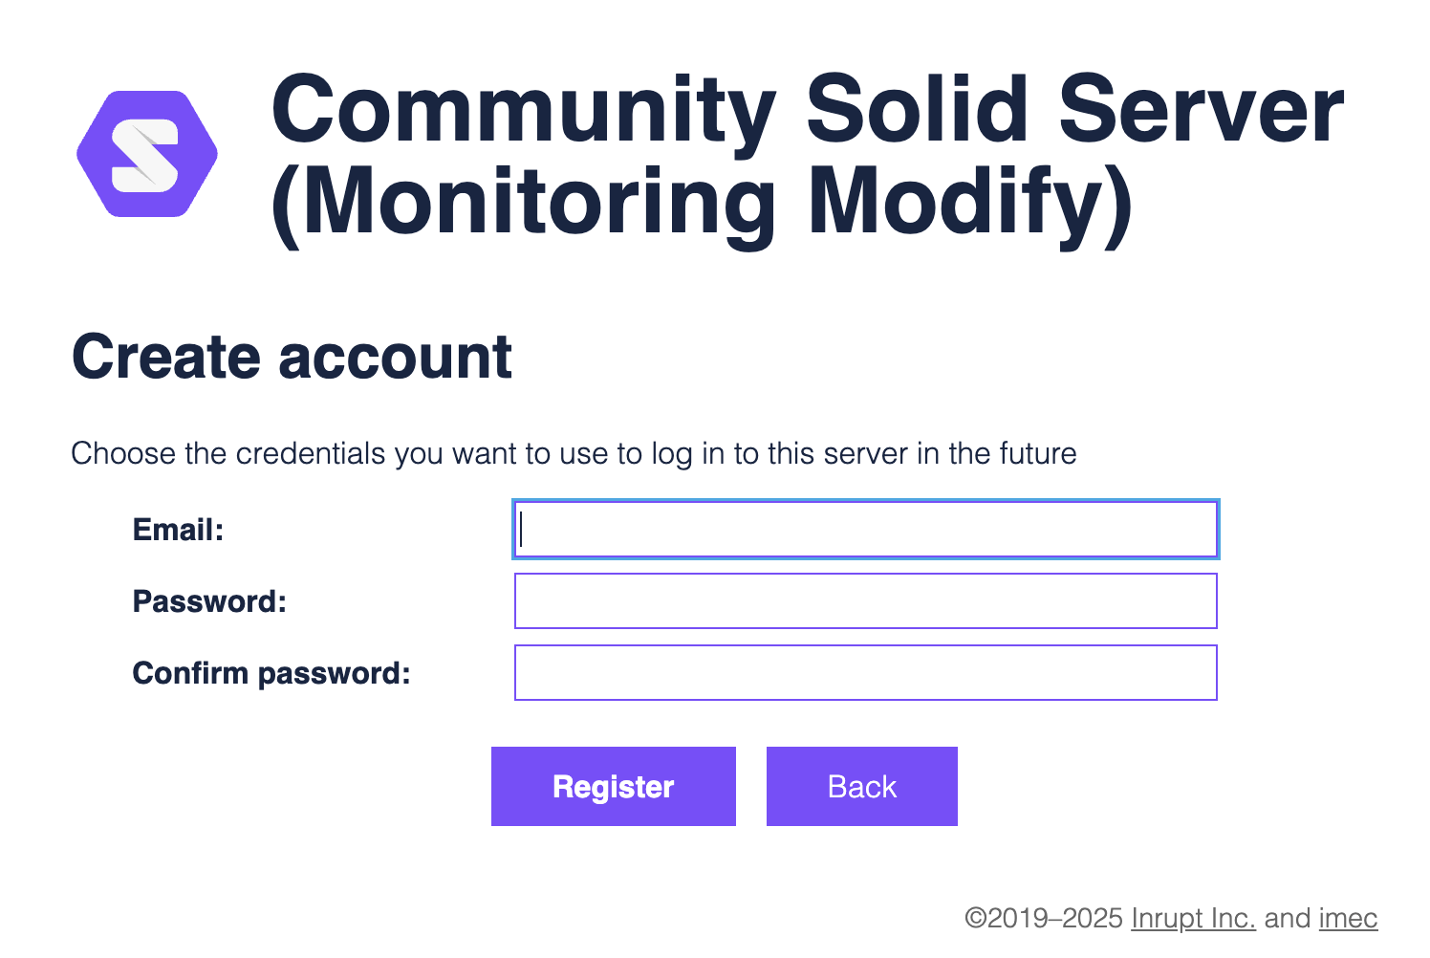
Section 1 : Solid Registration POD
Objective
Evaluate the registration, authentication, and Solid Pod connection process.
Assess the ease of creating and accessing a personal Solid Pod.
Evaluation Focus
Registration workflow clarity and usability.
Successful authentication and Solid Pod integration.
Note for Participants
Create a new Solid account using the provided server.
Complete the registration and login process successfully.
Evaluate the ease of registration and authentication.

Slide 8
Step Details
Step 1 : Access Monitoring Dashboard : https://solid-monitor-dashboard.vercel.app/
Step 2 : Insert link : https://solid-monitoring-addon-project-production.up.railway.app/
Step 3 : Click the login button
Step 4 : Click sign up for registration
Step 5 : completed the registration
Solid Registration Tutorial Video : https://drive.google.com/file/d/1N6Ymgko6Dy-etdooF-zHYBWpGdJsqqJ9/view?usp=sharing

Slide 9
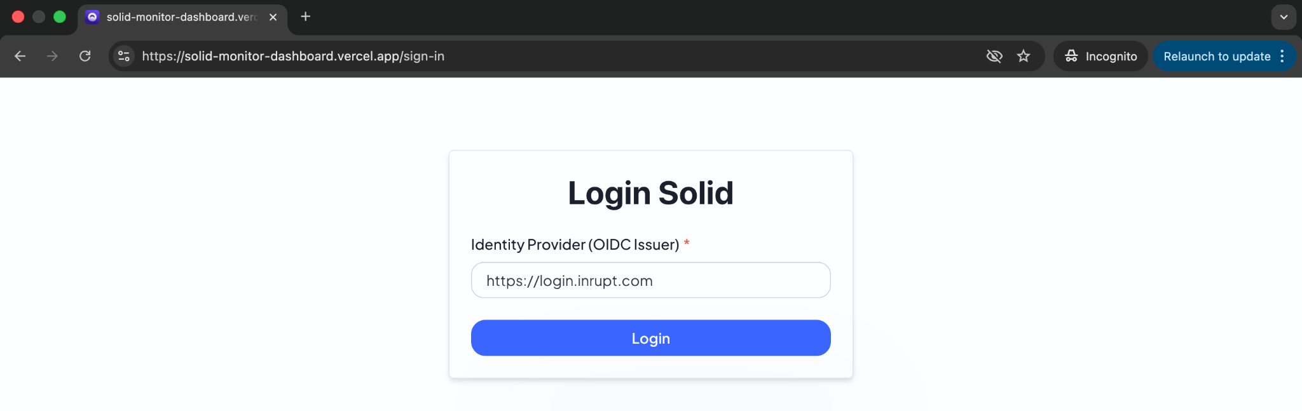
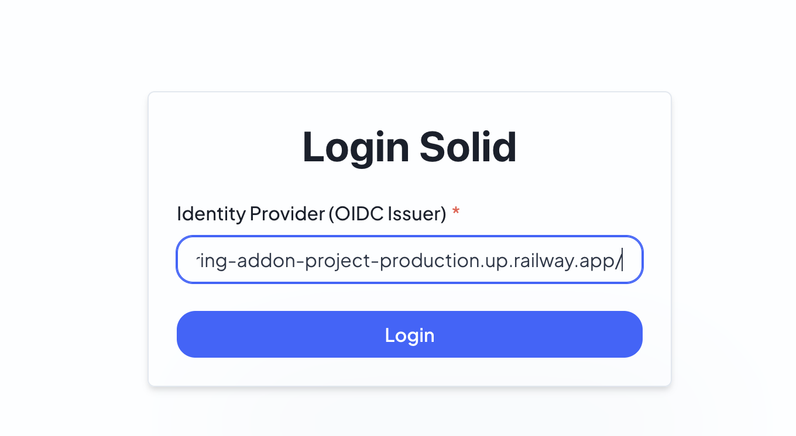
Output UI

Slide 10
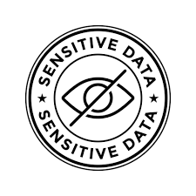
Section 2 : Setting Your Data Sensitive
Objective
Evaluate the process of selecting and managing sensitive personal data.
Assess the ease of configuring data protection preferences.
Evaluation Focus
Clarity of sensitive data configuration options.
Successful application of user-defined data protection settings.
Note for Participants
Select any personal data fields that you consider sensitive.
Save the privacy settings.
Evaluate whether the configuration process is easy to understand.

Slide 11
Step Details
Step 1 -> after login dashboard, move to privacy setting button (green)
Step 2 -> the modal form show the several data to mark sensitive or not (up to you to mark any data in this form)
Step 3 -> if you are done to mark, click save button
Tutorial Video :
https://drive.google.com/file/d/1JRz6h6Gm5MuAc14N3oGnMHahCV8qjRw4/view?usp=drive_link

Slide 12
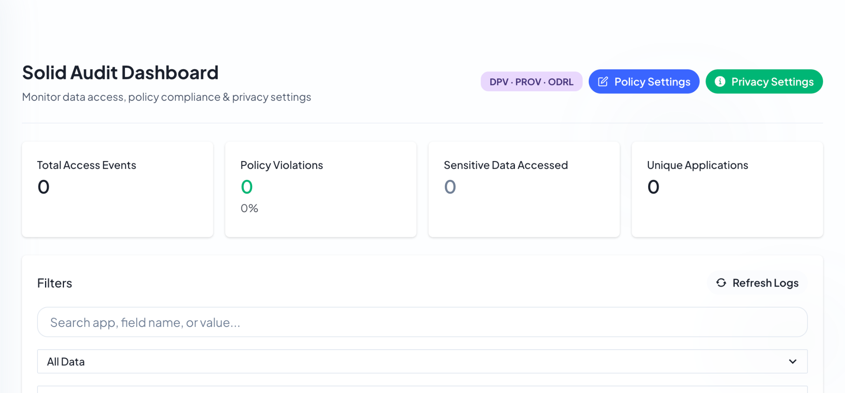
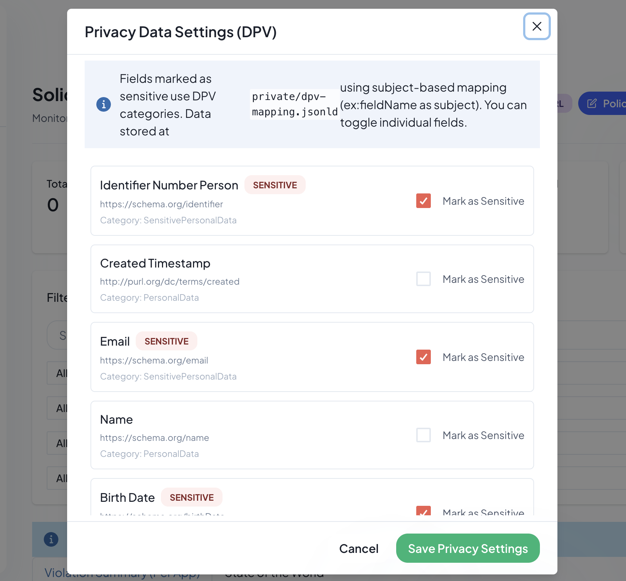
Output UI

Slide 13
Section 3 : Setting Your Policy
Objective
Evaluate the process of creating and configuring ODRL-based access policies.
Assess the ease of defining rules and restrictions for personal data access.
Evaluation Focus
Clarity and usability of policy configuration.
Successful application of user-defined access control policies.
Note for Participants
Create at least one ODRL policy.
Apply a constraint (access limit, time window, or location).
Evaluate the clarity of policy configuration.

Slide 14
Step Details
Step 1 -> go to button policy setting (blue button)
Step 2 -> after modal form show, klik add policy
Step 3 -> setting policy example you can choice “email” for policy setting
Step 4 -> fill the form description until constraint, in constraint you can choice access, location or time windows
Step 5 -> save
Tutorial Video : https://drive.google.com/file/d/1WUI4blvpx2vfXl3ud3dvxgzFHV6ZIRhb/view?usp=drive_link

Slide 15
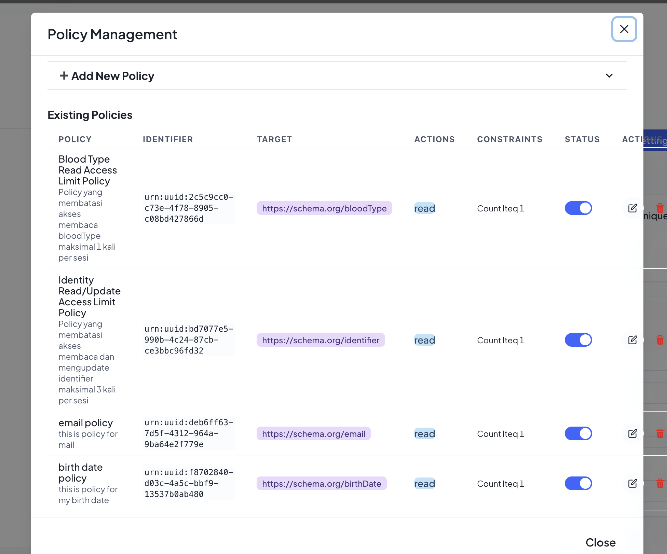
Output UI

Slide 16
Section 4 : Access Outside Apps
Objective
Evaluate how external applications request and access data from the user's Solid Pod.
Assess the effectiveness of policy enforcement during data access requests.
Evaluation Focus
Successful authorization or denial of data access requests.
Compliance of external applications with user-defined access policies.
Note for Participants
Login to the external application.
Share only dummy data.
Observe whether the system allows or denies access according to the policy.

Slide 17
Step Details
Step 1 -> Go to apps link : https://student-app-5afw.vercel.app/sign-in
Step 2 -> login with solid server : https://solid-monitoring-addon-project-production.up.railway.app/
Step 3 -> login to apps and setting the data you want share to apps
Step 4 -> insert your data (dummy data only not real)
Step 5 -> save
Tutorial Video : https://drive.google.com/file/d/1n5SeWZjFZ4aGHSdEi7R8p6_WDnf6NqOO/view?usp=drive_link

Slide 18
Section 5 : Historical Monitoring Dashboard
Objective
Evaluate the ability of the dashboard to provide transparent access history records.
Assess the effectiveness of monitoring data usage activities.
Evaluation Focus
Visibility of data access logs and audit trails.
Detection and reporting of policy violations and access events.
Note for Participants
Review the dashboard logs.
Check whether access events and violations are displayed correctly.
Evaluate the usefulness of monitoring information.

Slide 19
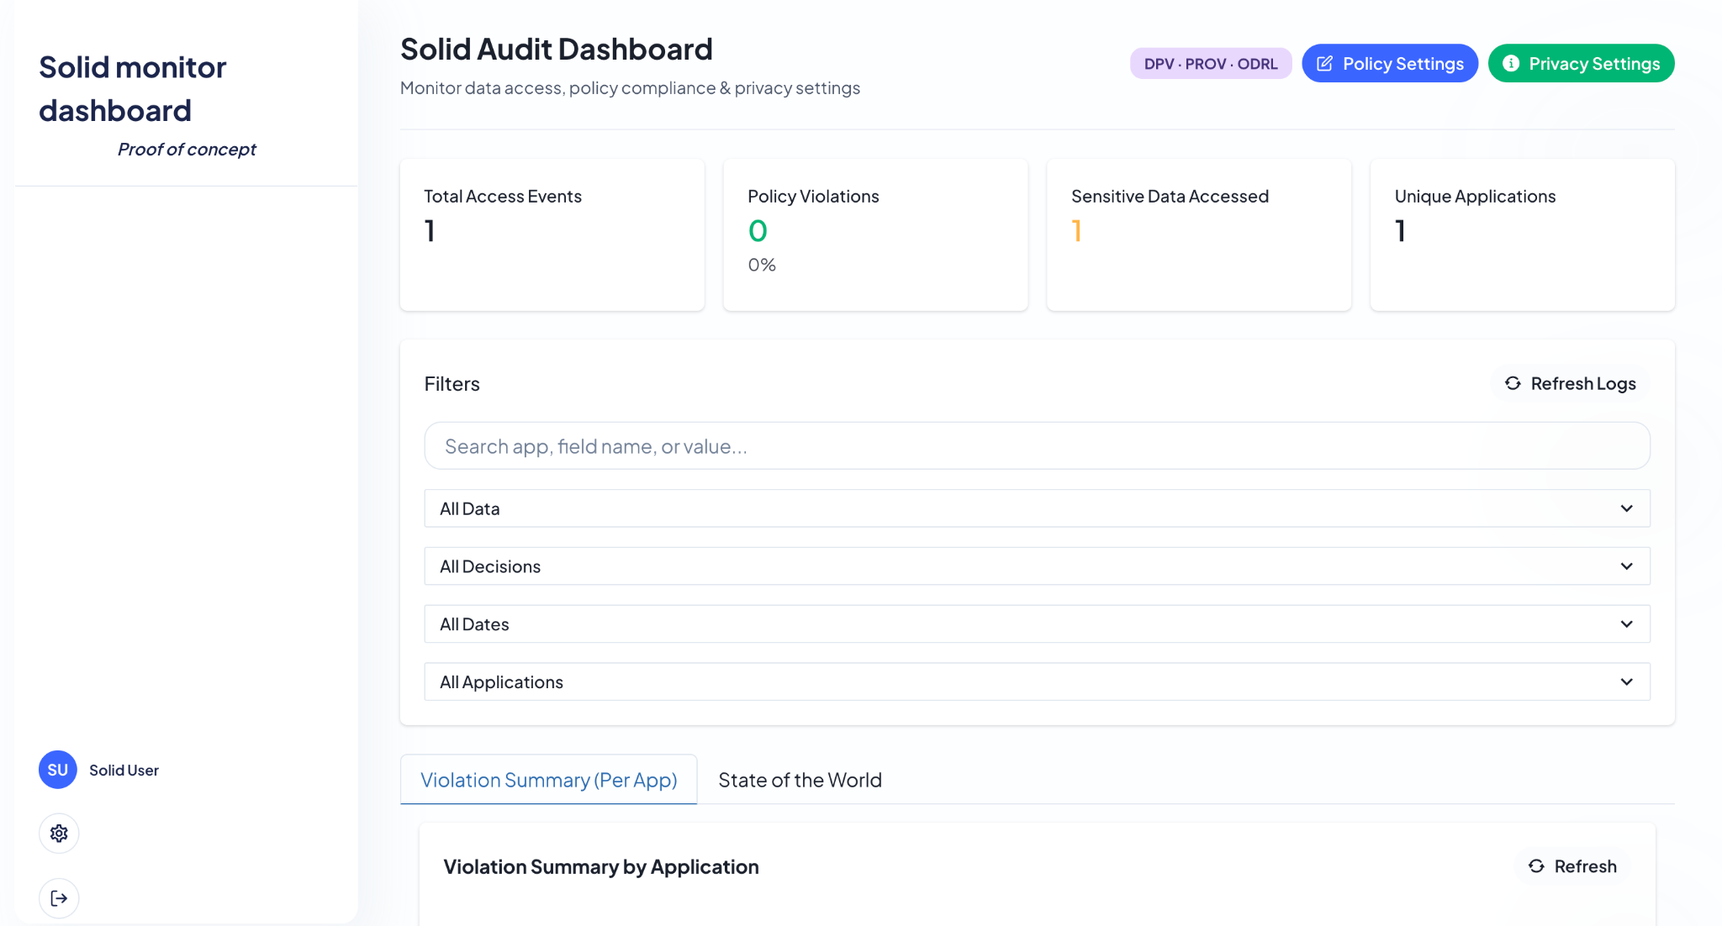
Output UI

Slide 20
Section 6 : Fill the evaluation form
Objective
Gather user feedback on the overall system experience.
Evaluate user perceptions of system functionality.
Note for Participants
Complete both questionnaires after finishing all testing tasks.
Answer based on your actual experience.
All responses will be used for research purposes only.
User Experience Evaluation
Assesses users' perceptions of usability, clarity, ease of use, and overall satisfaction.
Conducted using a questionnaire with a 5-point Likert scale after completing all testing scenarios.
Functionality Evaluation
Assesses whether system features operate according to their intended requirements.
Conducted by evaluating each functional scenario across the six testing sections.
Link Evaluation Form :
User Experience Evaluation : https://shorturl.at/XqYJV
Functionality Evaluation : https://shorturl.at/fRg72

